Slide 1
Optimum Receiver/filter:

Slide 6
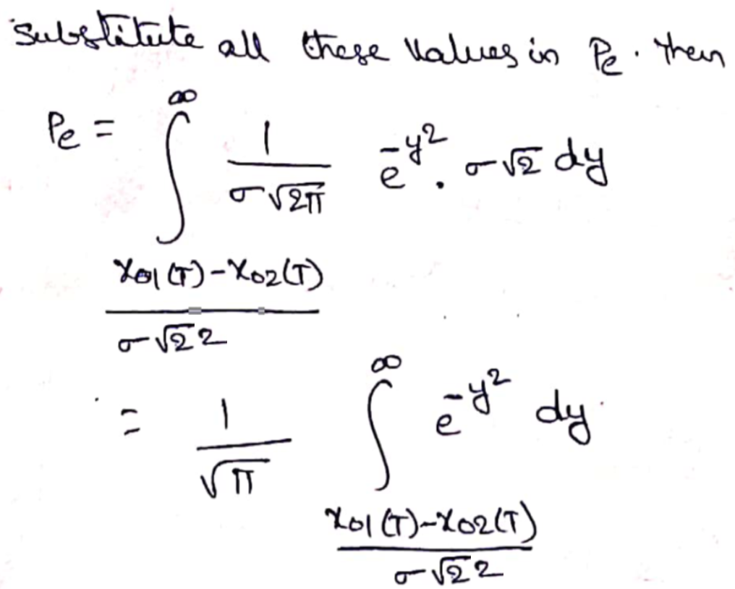

Slide 7
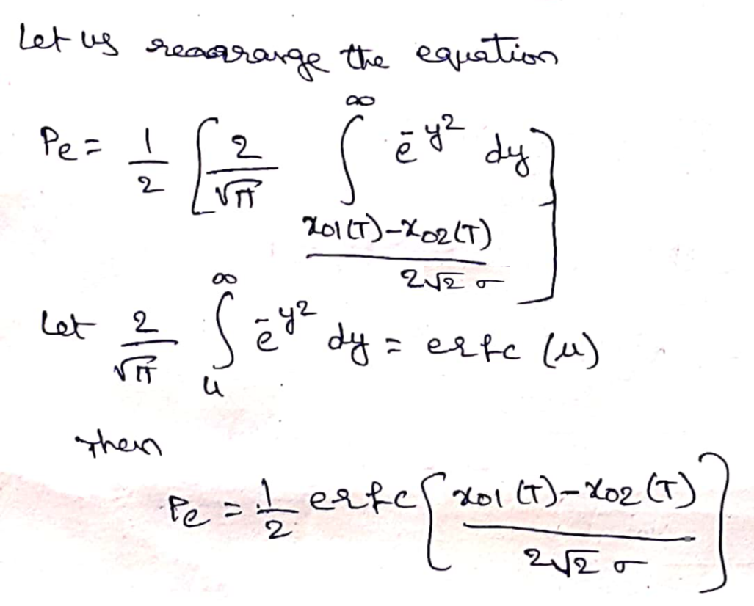

Slide 8
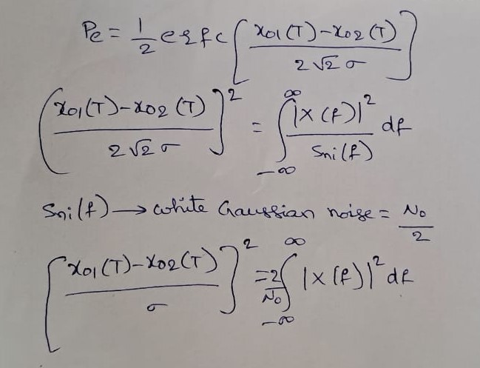
Matched Filter:

Slide 9
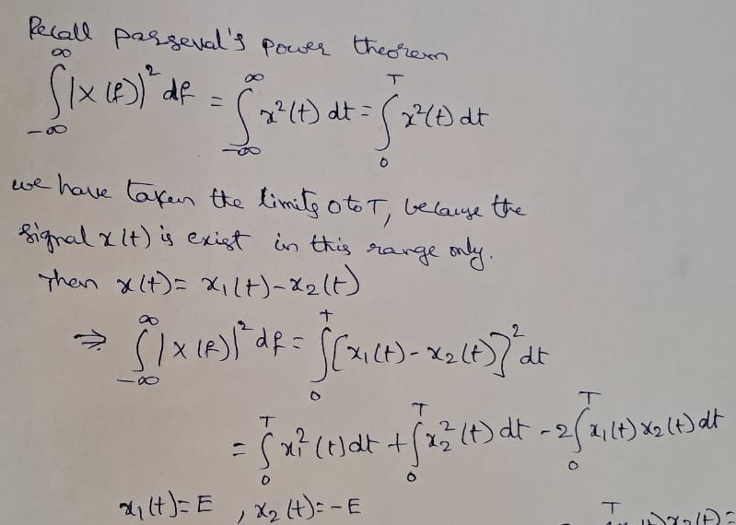

Slide 10
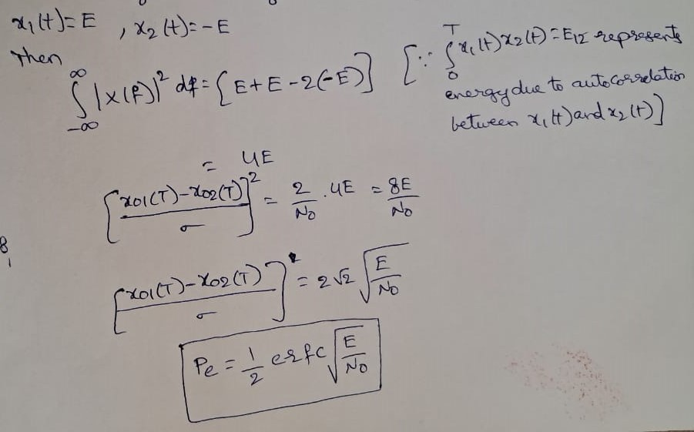

Slide 11
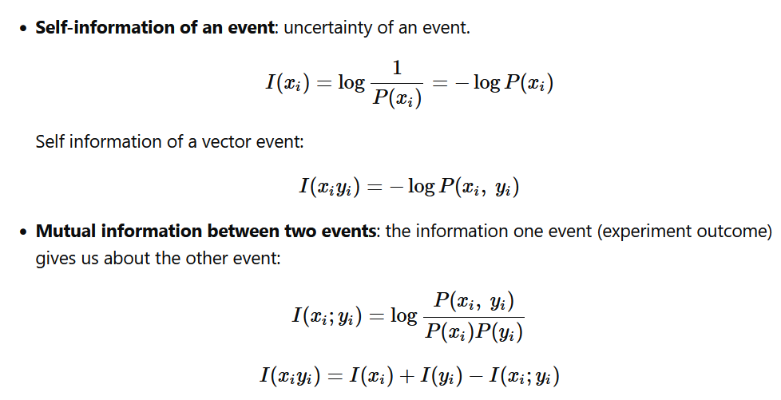
Information Theory:

Slide 12
2-bits 10-nats e-hartleys
In a binary source,0s occur three times as often as 1s. Find the information contained in the 0s and 1s. Express the information in bits, nats and hartleys
P(0)+P(1)=3P(1)+P(1)=1
P(0)=3/4 and P(1)=1/4

Slide 13
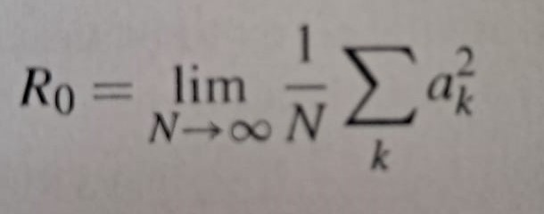
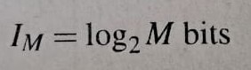
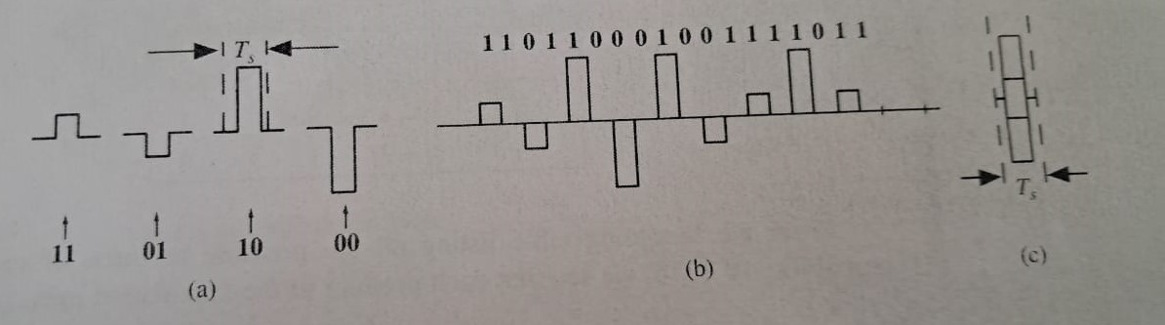
M-ary PAM with examples:

Slide 14
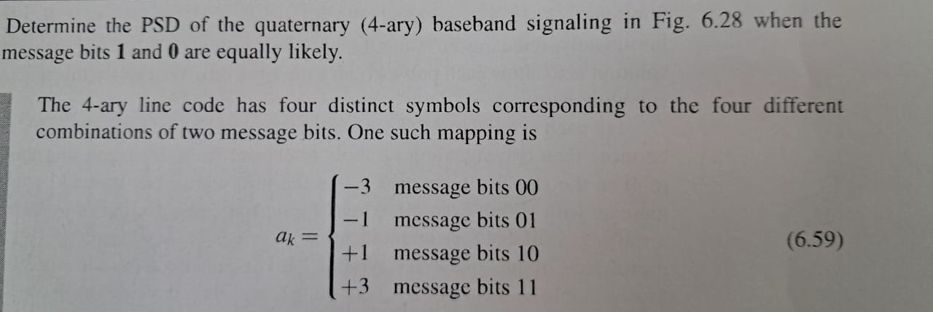

Slide 15
Pulse Shaping: Inter Symbol Interference
This is a form of distortion of a signal, in which one or more symbols interfere with subsequent signals, causing noise or delivering a poor output.
Causes of ISI
The main causes of ISI are −
Multi-path Propagation
Non-linear frequency in channels

Slide 16
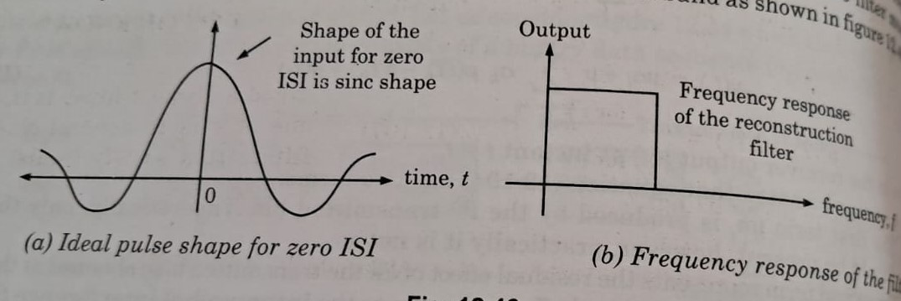

Slide 17
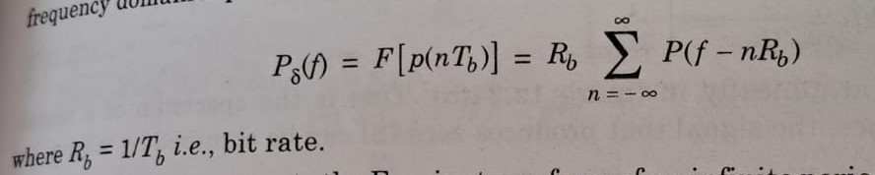
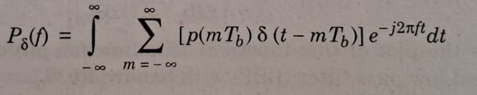
Nyquist Criterion for distortionless Baseband Binary Transmission:

Slide 18
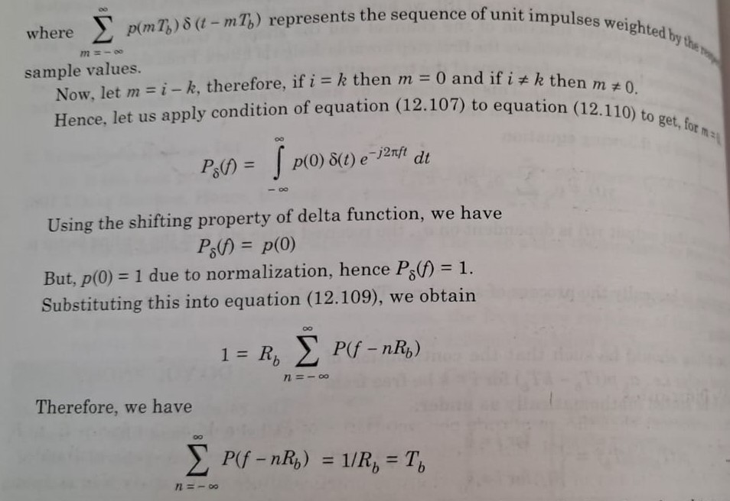

Slide 19
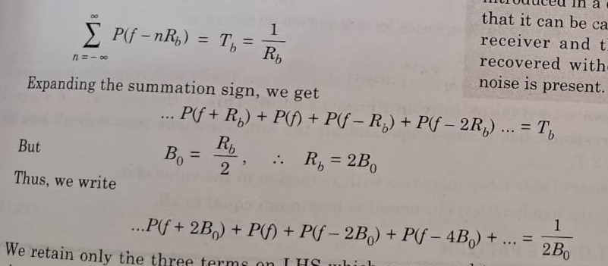
Raised Cosine filter:

Slide 20
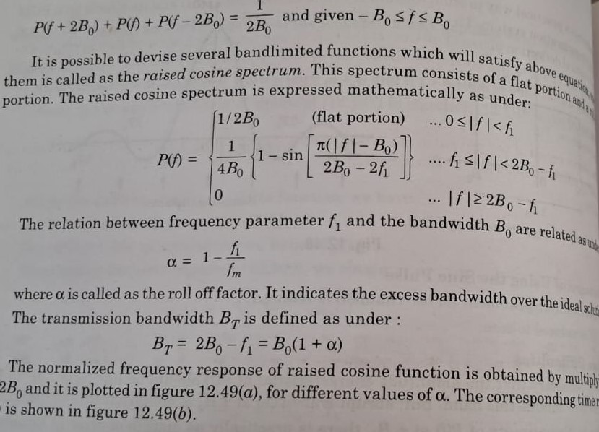

Slide 21
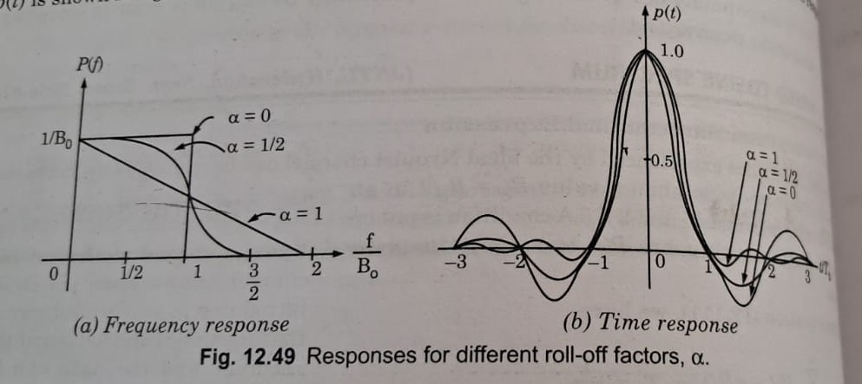

Slide 22
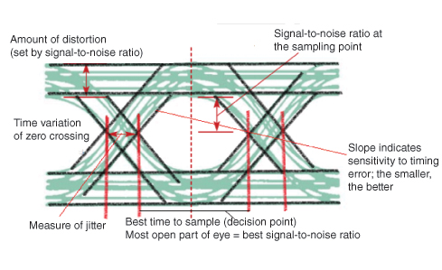
Eye Diagrams:
An effective way to study the effects of ISI is the Eye Pattern. The name Eye Pattern was given from its resemblance to the human eye for binary waves. The interior region of the eye pattern is called the eye opening. The following figure shows the image of an eye-pattern

Slide 23
Linear Equalizers:
A data modulated baseband pulse train is often attenuated and distorted by the transmission medium. The attenuation can be compensated by the preamplifier, whereas the distortion can be compensated by an equalizer.
The equalizer could also enhance the received channel noise by boosting its components at these critical frequencies. This undesirable phenomenon is known as noise enhancement or noise amplification.

Slide 24
i. Zero-Forcing Equalizer Design:

Slide 27
ii. Minimum Mean Square Error (MMSE) equalizer design:

